Slide 1
Regular Expressions for Real-World Text Processing
A.Sai Rohit (19272144)
DSA0307
Guided By:
Dr.K.Anbazhagan

Slide 2
Introduction
What are Regular Expressions (Regex)?
Regular Expressions (Regex) are patterns used to search and manipulate text.
They help identify specific text formats within large datasets.
Regex is supported in programming languages like Python, Java, JavaScript, and C#.
Applications
Data validation
Text searching
Information extraction
Data cleaning

Slide 3
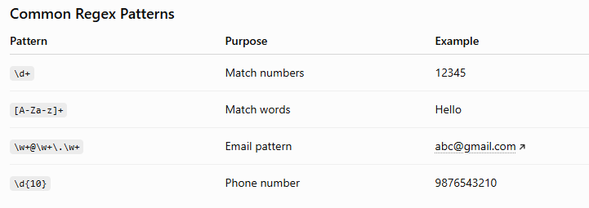
Pattern Matching Using Regex

Slide 4
Information Extraction
Extracting Useful Information
Regex can extract:
Email addresses
Phone numbers
Dates
URLs
IDs
PIN codes
Example
Input:
Name: Rahul Phone: 9876543210 Email: rahul@gmail.com
Output:
Phone → 9876543210
Email → rahul@gmail.com

Slide 5
Real-World Applications
Where is Regex Used?
Email validation
Password validation
Web scraping
Log file analysis
Benefits
Fast text processing
Accurate pattern detection
Reduces manual effort

Slide 6
Conclusion
Regular Expressions simplify text processing.
They efficiently perform pattern matching and information extraction.
Regex is widely used in software development, NLP, cybersecurity, healthcare, and data analytics.
Learning Regex improves automation and text analysis skills.

Slide 7
THANK YOU

